Slide 1
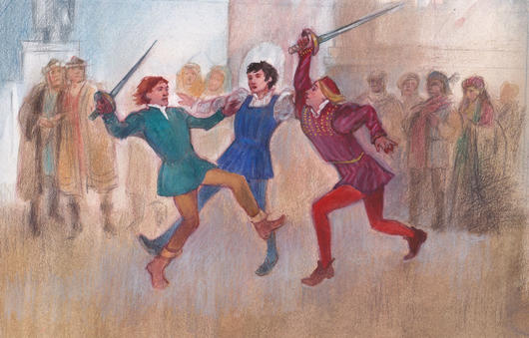
Act 1, Scene 4 & 5: Tybalt's Perspective During the Capulet Feast
Stop in the name of love!
He started it!
But he bit his thumb at me!
We have already seen how the play opens in the prologue, with key themes such as love and hate introduced to the audience by the chorus. We have also seen the use of ANTITHESIS in the prologue to encapsulate this key opposition in the play. We now plunge into an opening scene of VIOLENCE on the streets of Verona.

Slide 2
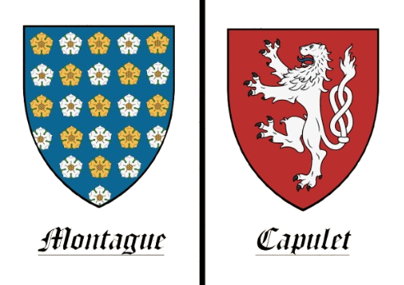






Act I, Scene I-V: R&J Opening
What are these all examples of…?
CAPULETS vs. MONTAGUES
LOVE vs. VIOLENCE
Juxtaposition
Antithesis
MOON vs. SUN
INDIVIDUAL vs. SOCIETY

Slide 3


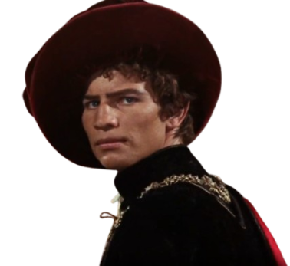
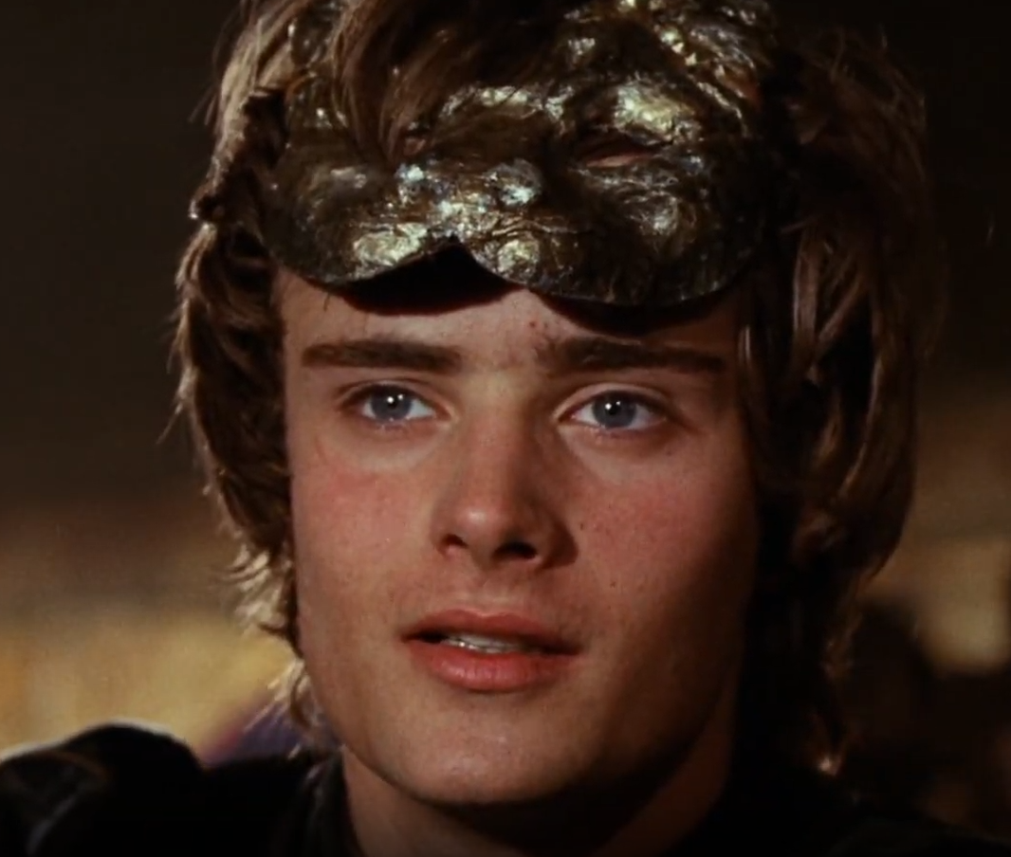



Act I, Scene V: Tybalt’s Frustration
Context
During the Capulet Party, Tybalt notices Romeo has snuck in and is outraged
Is that a Montague???
@#$%&*!
I must tell uncle! This is a Montague, our foe!
Did my heart love till now? Forswear it, sight! For I ne’er saw true beauty till this night
– 1.5.51-52 (Page 41)
Take out your English Pink Book, be ready to write and list down alternative words

Slide 4
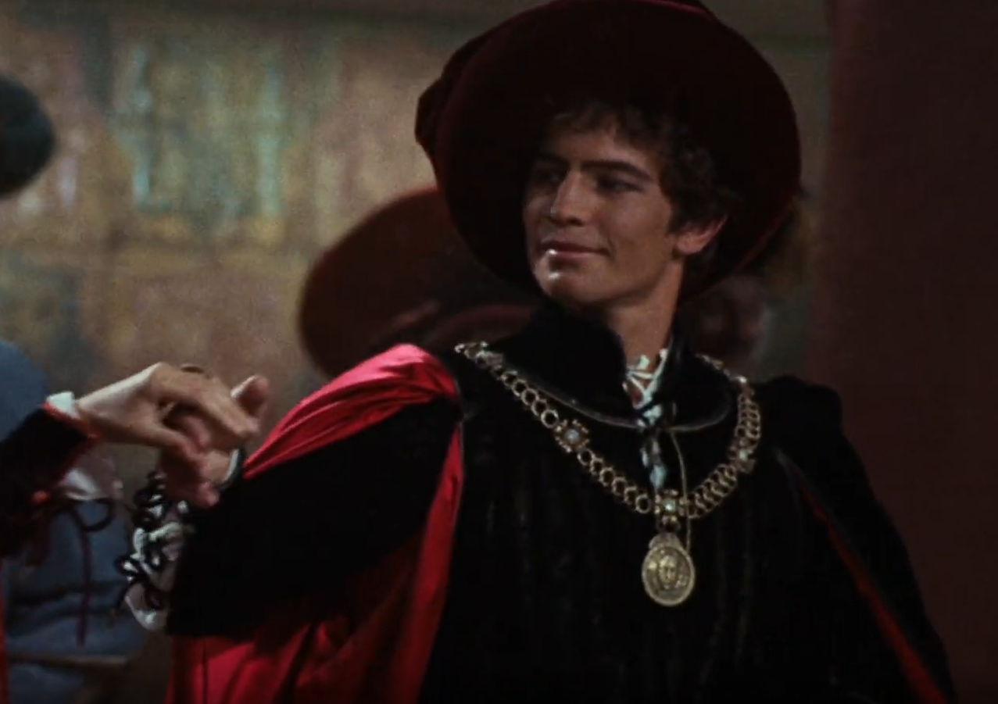
Act I, Scene V: Vocabulary Builder
This is before Tybalt is aware of Romeo gatecrashing the party
How would you describe Tybalt’s current state?
What first impressions do you have? What words come to mind?
Courteous
Happy
gracious
well-mannered
joyful
elated
polite
civil
prideful
ecstatic
Calm
gentle
tempered
restrained
controlled
Pleasant
delighted
lighthearted
Remember, you are writing as Tybalt! First Person!
Smiling
amiable
agreeable
positive
beaming
grinning
smirking

Slide 5

Act I, Scene V: Discerning Emotions
This is before Tybalt is aware of Romeo gatecrashing the party
Improve these words - find different synonyms!
Vary your descriptions and how Tybalt thinks and acts
Courteous
Happy
gracious
well-mannered
joyful
elated
Calm
gentle
tempered
Pleasant
delighted
lighthearted
Smiling
Visual:
Tybalt is in dress robes for a special occasion - Capulet Feast
positive
beaming

Slide 6
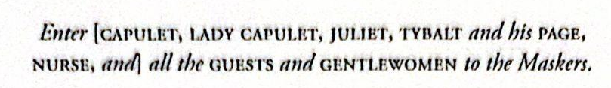
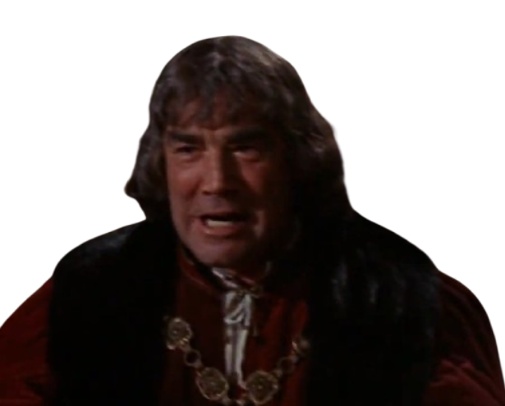

Act I, Scene V: Sensory Details
This is before Tybalt is aware of Romeo gatecrashing the party
What can you see? What sounds can you describe?
Courteous
Happy
gracious
well-mannered
joyful
elated
As I stood up from my table, the servingmen silently came to clear it. I did not spare a glance at their work as I approached the center of the hall, the lively and pleasant music filtering out the rustling and clinking of porcelain and utensils behind me.
Calm
gentle
tempered
Pleasant
delighted
lighthearted
Smiling
My uncle’s loud and elated voice boisterously echos in the background as I stand next to my aunt, smiling and greeting the guests.
positive
beaming

Slide 7
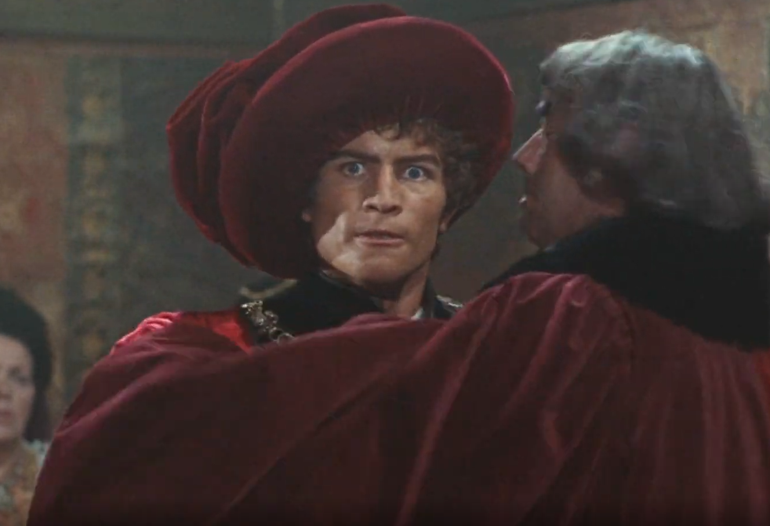
Act I, Scene V: Discerning Emotions
This is when Tybalt confronts his Uncle, Lord Capulet, about Romeo’s presence
How would you describe Tybalt’s current state?
What describes his behaviour now? What words come to mind?
Angry
Frustrated
incensed
furious
aggravated
annoyed
Outraged
appalled
indignant
Glaring
Impatient
Remember, you are writing as Tybalt! First Person!
scowling
glowering
intolerant
restless

Slide 8
Act I, Scene V: Visual Indicators
This is when Tybalt confronts his Uncle, Lord Capulet, about Romeo’s presence
What facial expressions can you describe?
Remember to SHOW and not TELL
Angry
Frustrated
incensed
furious
Body is tense and ready to fight
aggravated
annoyed
Outraged
appalled
indignant
Glaring
Impatient
scowling
glowering
intolerant
restless
Eyes twitching, filled with indignant rage
Jaw clenched, barely holding on to his anger

Slide 9
Act I, Scene V: Using Imagery
This is when Tybalt confronts his Uncle, Lord Capulet, about Romeo’s presence
What Similes or Metaphors can you use to unpack these emotions identified in Tybalt?
Angry
Frustrated
incensed
furious
Like twin suns of scorching wrath, I scowled hatefully at how Romeo pranced about in the hall.
aggravated
annoyed
Outraged
I remember standing there, frustrated at how that trespassing leech stood amongst the house of Capulet. I glared daggers at the Montague spawn as my hand trembled with barely controlled fury.
appalled
indignant
Glaring
Impatient
My blood boiled at the sight of him. It was appalling that he struts across our candlelit hall like he owned this place. That wretched Montague ought to be struck down for such a scornful act.
scowling
glowering
intolerant
restless

Slide 10
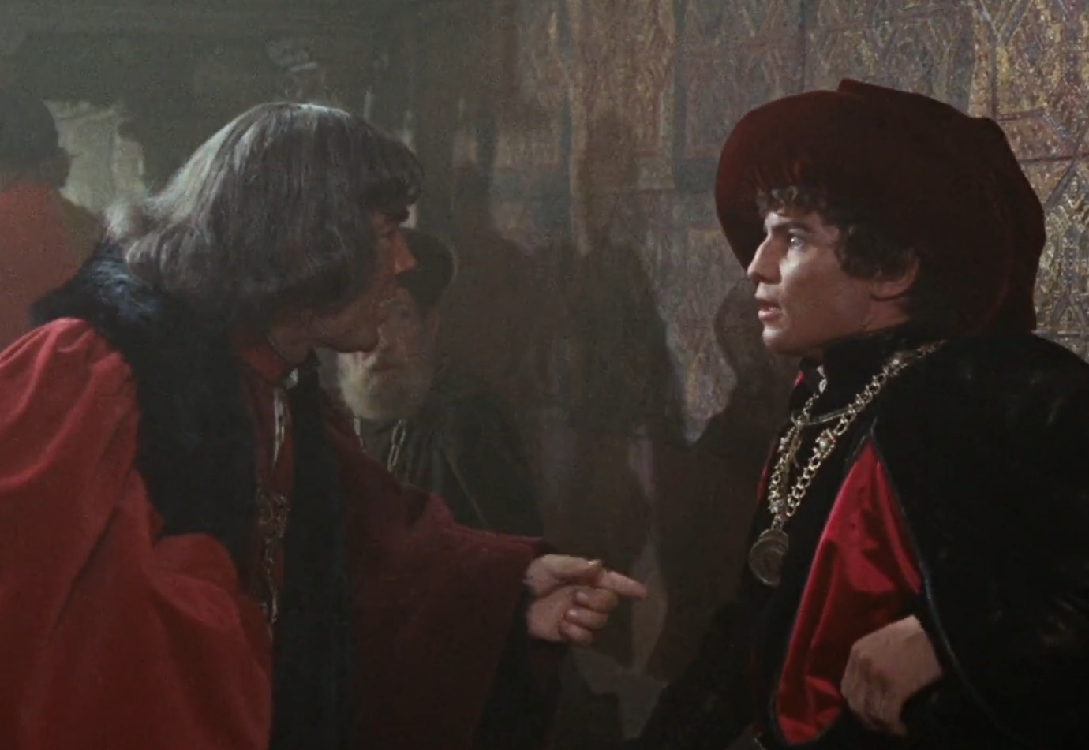
Act I, Scene V: Developing Imagery
Tybalt’s Uncle, Lord Capulet is now furious that he will not leave Romeo be.
How would you describe Tybalt’s current state?
What has changed in his behaviour? What words come to mind?
Fearful
Nervous
scared
afraid
embarrassed
apprehensive
Why does Tybalt’s confidence and violent nature suddenly change?
Describe why he–a man that would dare challenge and fight anyone–is suddenly scared!
Shocked
surprised
stunned
Remember, you are writing as Tybalt! First Person!

Slide 11
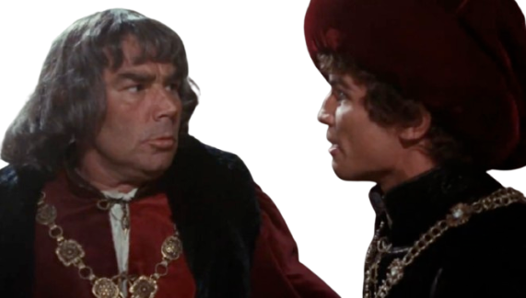
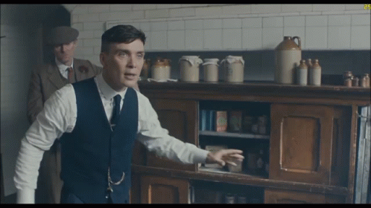
Act I - R&J Empathic Practise
You need to dive deeper into your character!
I am Tybalt at the moment where he writes a Diary after the Capulet Feast where he spots Romeo (Act 1, Scene 5)
What might be some of the emotions that Tybalt feels?
What does Tybalt understand about the situation?
What meaningful events in the play is the moment linked to?
Tribal loyalty to the Capulets
Obsession with martial skill
(Warrior archetype - Quick to Anger, Violent, obsession with his own version of honor)
Unwilling to accept the Prince’s decree of not fighting in the streets, as he believes he should fight any Montague on sight
He was raised to blindly participate in his family's ancient, generations-long feud with them
Because of the values he was raised with (hatred of Montagues), he does not understand the finer details of why Lord Capulet refuses to do anything about Romeo in the Capulet Ball.
NO FIGHTING!

Slide 12
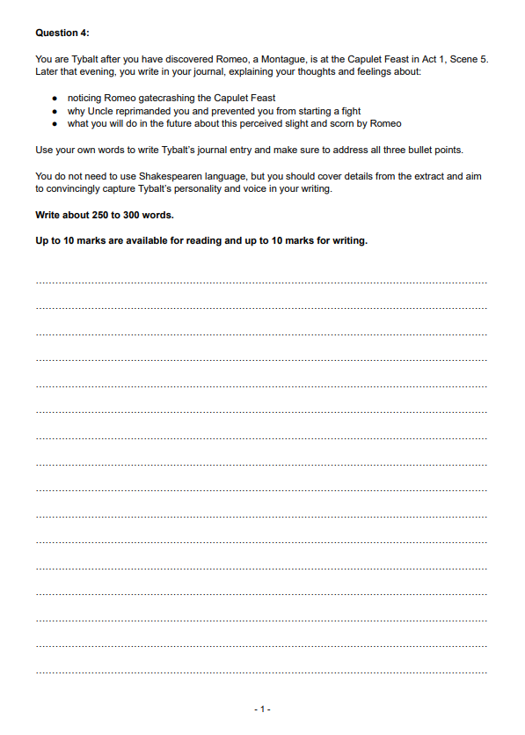
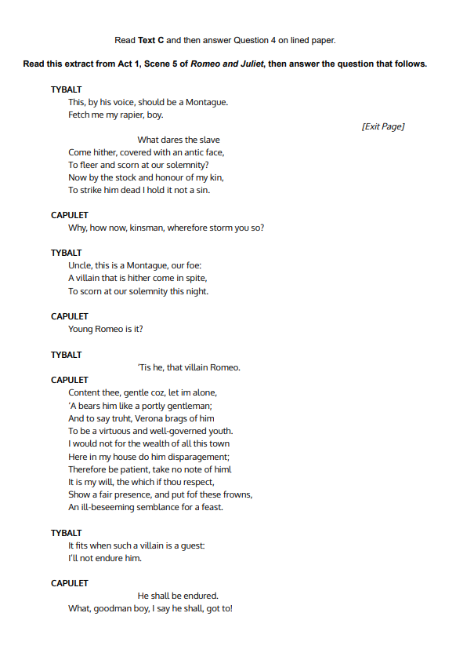

Act I - R&J Empathic Practise
I am Tybalt at the moment where he writes a Diary after the Capulet Feast where he spots Romeo (Act 1, Scene 5)
What might be some of the emotions that Tybalt feels?
What does Tybalt understand about the situation?
What meaningful events in the play is the moment linked to?
NO FIGHTING!
NEW* Tybalt at Capulet Feast (R&J) insert - P1 Q4

Slide 13
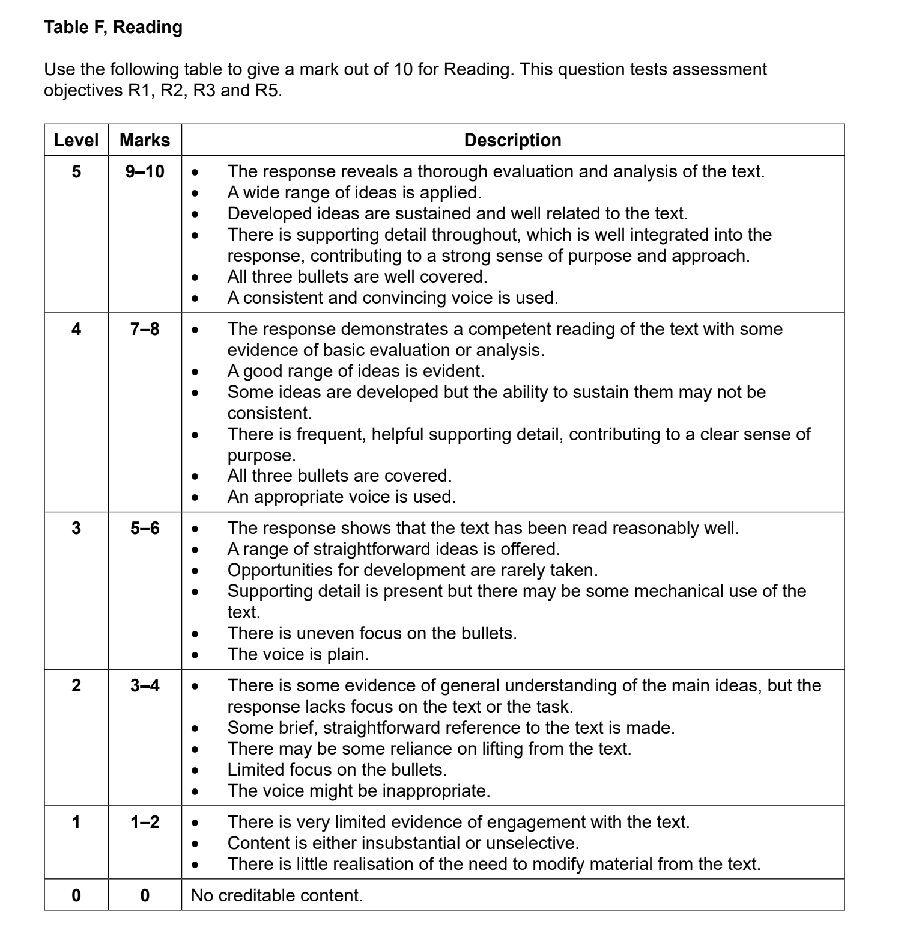
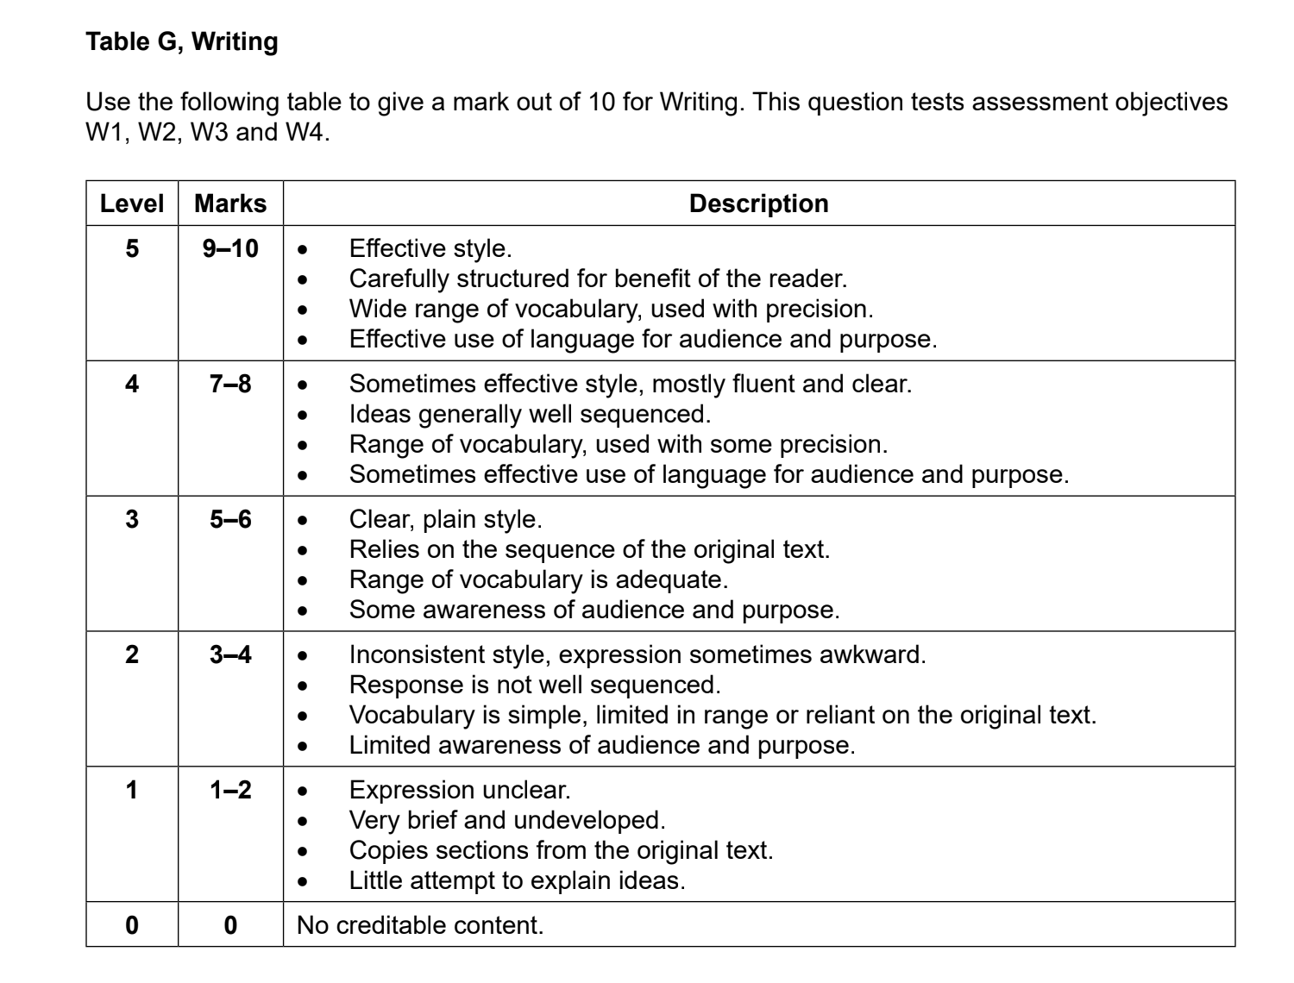
FLE Qu4
GENERIC
MARK SCHEME:

Slide 14
Act I - R&J Integrating language
Sample Starter:
July 12th, 1464
Dear Diary,
A most outrageous event occurred earlier this evening, during our old accustomed Capulet Feast. That Montague, Romeo, dared to scorn us Capulets! Our foe dared to trespass on our sacred grounds and invade our territory under a guise! Under normal circumstances, I would have drew my rapier and eliminated such a villain. However, Uncle would not allow me to do so.
My Uncle, the esteemed Lord Capulet, strongly rebuked me and insisted on this… peace. Peace, oh how I hate the word! I was so frustrated because I could not strike down our foe for doing something so spiteful.
Sample Starter:
July 12th, 1464
Dear Diary,
A most outrageous event occurred earlier this evening, during our old accustomed Capulet Feast. That Montague, Romeo, dared to scorn us Capulets! Our foe dared to trespass on our sacred grounds and invade our territory under a guise! Under normal circumstances, I would have drew my rapier and eliminated such a villain. However, Uncle would not allow me to do so.
My Uncle, the esteemed Lord Capulet, strongly rebuked me and insisted on this… peace. Peace, oh how I hate the word! I was so frustrated because I could not strike down our foe for doing something so spiteful.
Words taken from the text
Integrate language from your extract for good developed of ideas
NEW* Tybalt at Capulet Feast (R&J) insert - P1 Q4

